Slide 1



Data science to support sustainable viticulture
Notes:
Hello my name is Bryce Polley I am Kerrie Mengersen's Masters Student who has been based at Waite campus working with the Australian Wine Research Institute, Sustainable Winegrowing Australia and the Food Agility CRC on the project: Data Science to support sustainable Viticulture.

Slide 2

Acknowledgement of Traditional Owners
Notes:
I would like to begin by acknowledging the Traditional Owners of the land at QUT, who are the Turrbal and Yugara people, and at the Waite campus where I am frequently situated in the AWRI, who are the Kaurna. people.

Slide 3
Introductions
Bryce – QUT/SWA
Mardi - SWA
Kerrie – QUT
Robyn – AWRI
Hans – Penley
Brooke – Jim Barry Wines
Marcel – AWRI
Alex – Wine Australia

Slide 4
Itinerary
15m Introduction
Project Summary
Example yield model
Introduce strawman model
10m Main factors
What are the significant factors
What would we like to include
20m Probability tables
Evaluating and filling out likelihoods
10m Evaluation of the network
Review of likelihoods and network structure
15m Scenario assessment
Discuss potential scenarios
Review how sustainable different scenarios are
15m Discussion
Discuss merits and pitfalls
Potential further adjustments and direction
This is a tight schedule:
We will keep a later list for things to address that we do not get to in the workshop
If you have queries write them down incase we do not get to them today and you can email us!

Slide 5
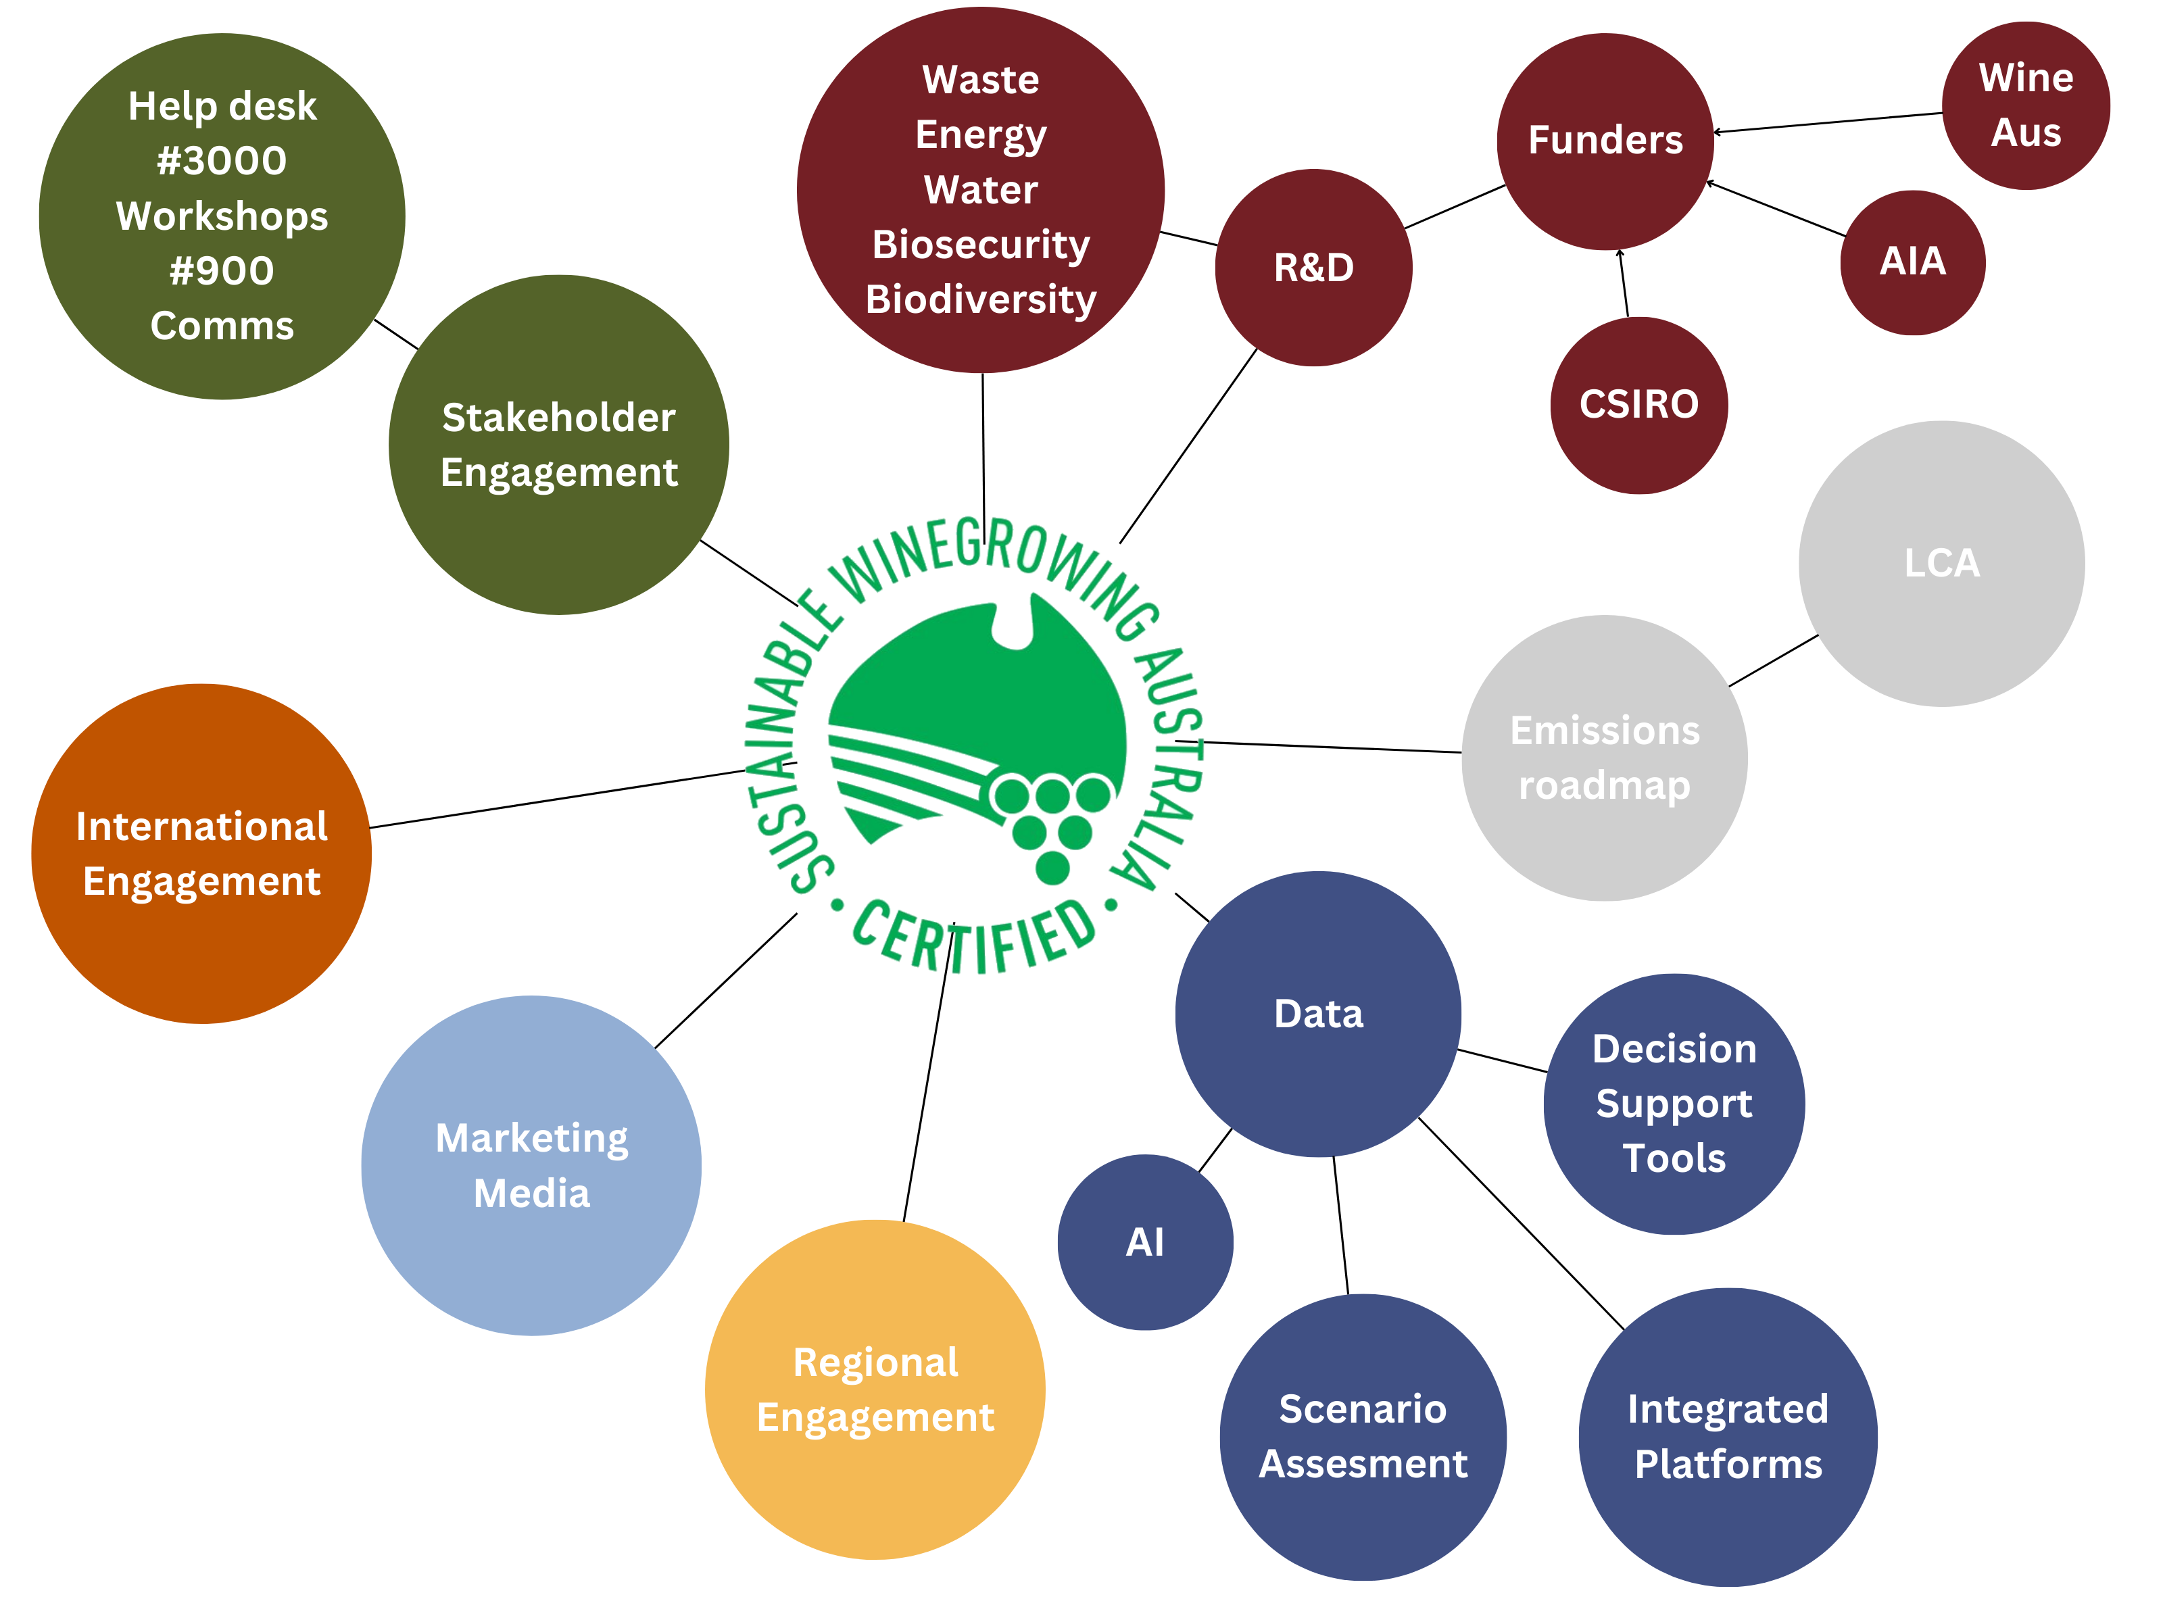
Notes:
As most of you know Sustainable Winegrowing Australia is a central hub of activity
INTRO PINK BUBBLES - One of it’s core functions is the collection of production and resource use data in the areas of waste, energy, water etc. These can be used to inform R&D and there is an important feedback loop here, but it has also enabled us to build broader relationships with funding bodies and other R&D organisations
INTRO GREY BUBBLES – last year we used the Sustainable Winegrowing Australia data to inform the wine industry’s emissions roadmap and Kieran re-analysed the sector’s Life Cycle Analysis
INTRO YELLOW BUBBLES – The Sustainability team uses the program and its data to engage in the regions around their own priority areas and
INTRO THE JADE BUBBLE – earlier this year the data was used in marketing and media campaign around the Impact report
INTRO THE ORANGE BUBBLE – International engagement around the program is continuing to strengthen AND
INTRO THE GREEN BUBBLES – locally, Sustainable Winegrowing Australia provides an opportunity to engage with stakeholders that the AWRI does not often touch – GROWERS – last year the team responded to around 3000 helpdesk queries from growers and more than 900 producers came through sustainability workshops with the team
INTRO THE BLUE BUBBLES – so I am here to talk to you about the data. In particular, my project which uses the Sustainable Winegrowing data and applies AI etc… (add your own words here. Your words below are good)
We aim to use the data to help sustainable efforts
to inform growers with data
Through the investigation of data
The uncovering of synergies, unknown trends and link practices to sustainability
Centre icon -> Make it the trust mark
Figure out an order to introduce the components and how they interact – landing on data at the end

Slide 6
What data do we have?
Resource use
Operational data
Production data
National dataset
Long term data
Water
Fuel
Electricity
Operational Costs
Gross Profit
Cover Crop types
Yield
Price per Tonne
57 Regions
1441 Sites
+10 years
Notes:
Make it really clear
-production data
yield
-resource use metrics
Fuel
electricity
-operational decisions
Cover crops
Financial data
Profit
Operational cost
Summarise the data, 1441 vineyards, 57 regions, 10 years.
Map of aus

Slide 7
What data do you have?
Resource use
Operational data
Production data
National dataset
Long term data
Notes:
Make it really clear
-production data
yield
-resource use metrics
Fuel
electricity
-operational decisions
Cover crops
Financial data
Profit
Operational cost
Summarise the data, 1441 vineyards, 57 regions, 10 years.
Map of aus

Slide 8
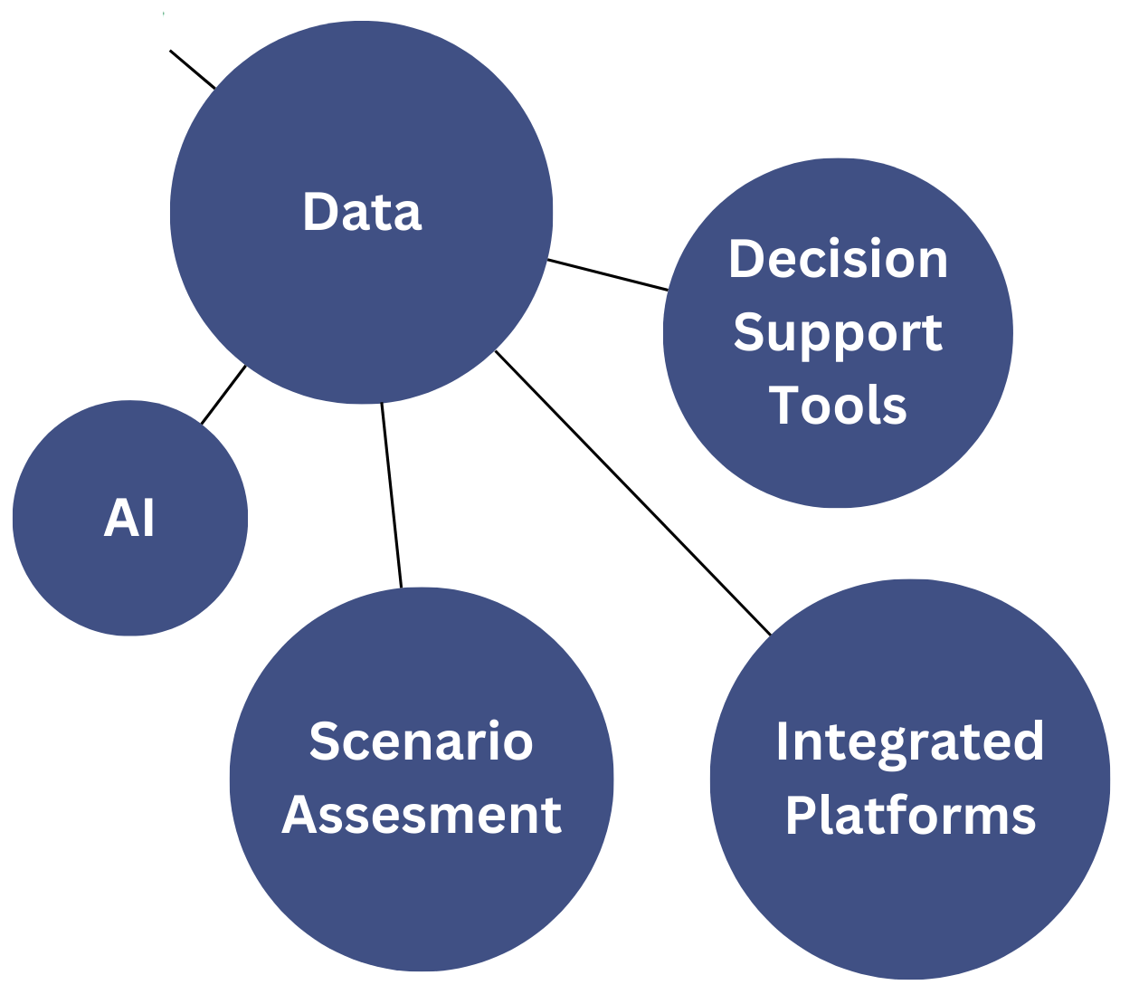
Project Aims
Empirical assessment and comparison
Assisting the industry
Notes:
Describe what is known, a tool to communicate with industry and experts
Data exploration to look at what are new possibilities within the data?
Can we accurately predict things?
Can we explain these predictions?
What were the possible alternative outcomes if things had been done differently?

Slide 9

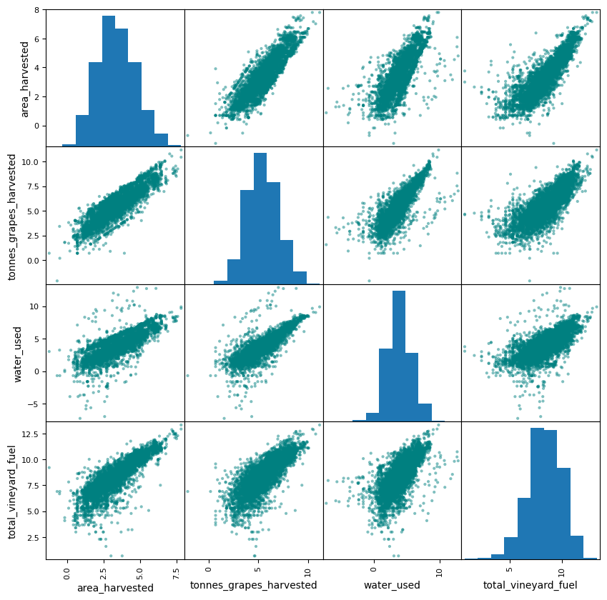
Baseline Models
Anomaly detection
Automation of data input warnings
A tool to communicate with viticulturists
Reality in numbers
Resource use Correlation Matrix
Notes:
The first steps were understanding the data, and how the data translated to the real world. What was it we were looking at.
What values make sense, what are likely input errors, why do people record this?
We were able to help increase the rate at which errors were picked up.

Slide 10
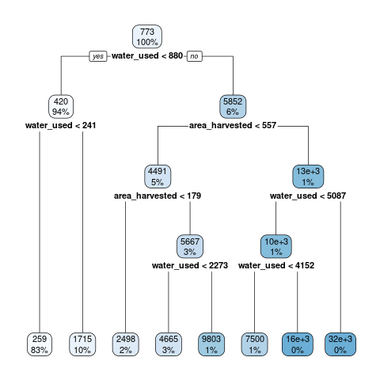
Exploratory Analyses
Operational costs
Gross Profit
Disease Pressures
Regression Tree: Yield
Notes:
More models are under development looking at critical factors to vineyard success such as operational costs and profits. Thus far the most accurate has been the prediction of disease pressure.

Slide 11
Sustainability as a complex system
There are many factors involved in
In decision making
Managing resources
Prioritisation
We need a model that:
captures this complexity
Includes a wide variety of information (data and expert knowledge)
Addresses uncertainty
Identifies important factors
Allows for Scenario assessment
One such approach is a Bayesian Network

Slide 12
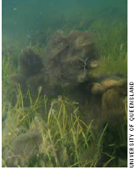
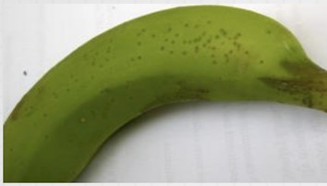

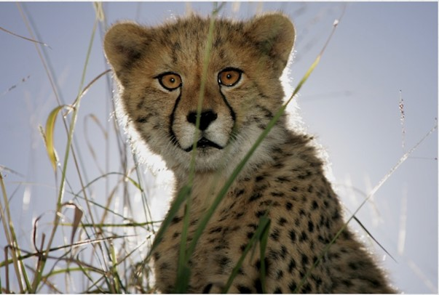
Everything is a complex system!

Slide 13
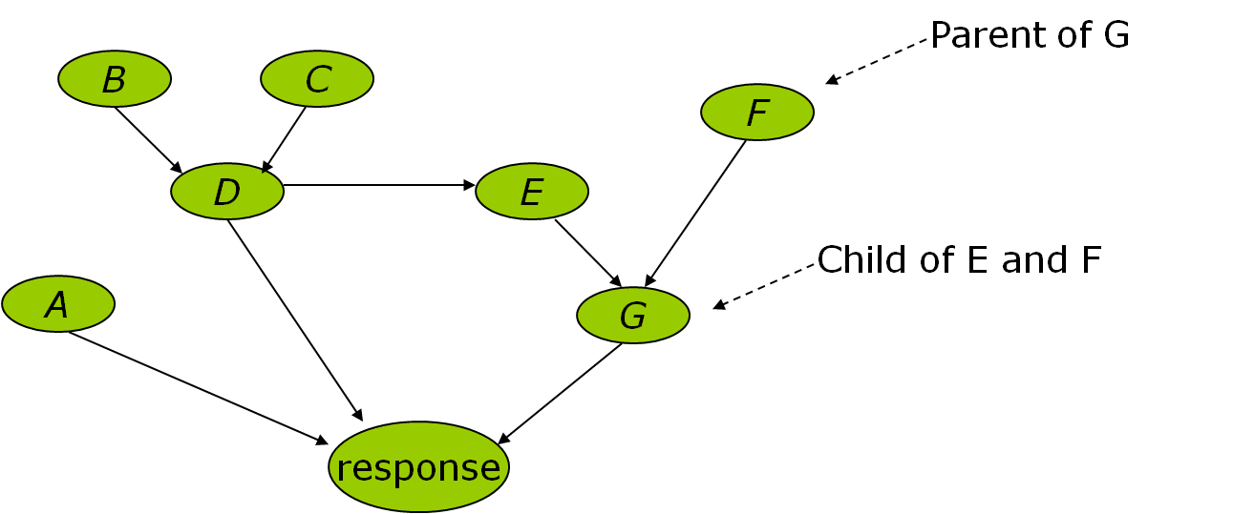
Using Bayesian Networks to model complex systems

Slide 14
Consider separate subnetworks
- child only depends on parents
Then link them together
F
E
G

Slide 15
Quantify each node using available information:
data
literature
model outputs
expert judgement
etc
F
E
yes
no
Prob
?
?
F
low
medium
high
F
low
medium
high
E
G

Slide 16
Quantify each node using available information:
data
literature
model outputs
expert judgement
etc
 |  | G
E | F | normal | high
yes | low
 | medium
 | high
no | low
 | medium
 | high
F
E
G

Slide 17
Quantify each node using available information:
data
literature
model outputs
expert judgement
etc
 |  | G
E | F | normal | high
yes | low | 0.4 | 0.6
 | medium | 0.2 | 0.8
 | high | 0.1 | 0.9
no | low | 0.5 | 0.5
 | medium | 0.6 | 0.4
 | high | 0.4 | 0.6
F
E
G

Slide 18
Why Bayesian Networks?
Bring together disparate scientific knowledge
Create a ‘conceptual map’ of the scientific drivers
Quantify the map with data, model outputs, expert knowledge, etc
Identify key drivers
Explore scenarios of change
Understand impact of management and policy decisions

Slide 19
Case study: Bayesian network modelling of lyngbya
What are the drivers of lyngbya?
What management actions should be taken?
University of Queensland
Caboolture Shire Council

Slide 20
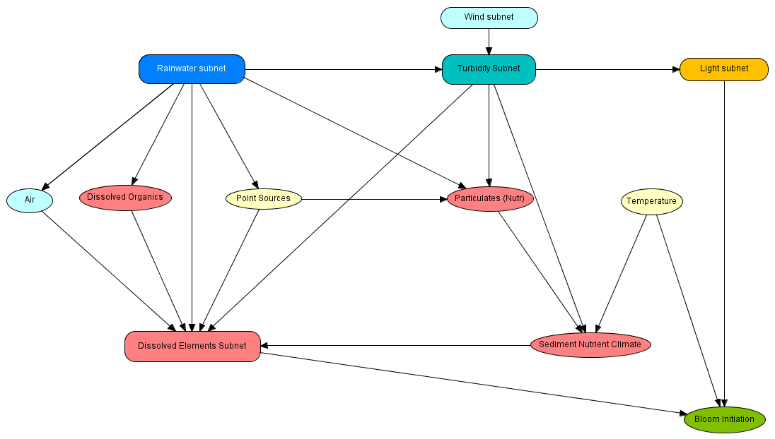

Slide 22
Most influential factors
MANAGEMENT
ACTIONS
Available Nutrient Pool
Bottom Current Climate
Sediment Nutrients
Dissolved Iron
Dissolved Phosphorous
Light
Temperature

Slide 23
“What-if” scenarios
Factor | Change in P(Bloom) (%)
Available Nutrient Pool | 77 (3% - 80%)
Bottom Current Climate | 28 (15% - 43%)
Sediment Nutrient Climate | 17 (21% - 38%)
Dissolved Fe | 16 (21% - 37%)
Dissolved P | 15 (23% - 38%)
Light Climate | 14 (18% - 32% )
Temperature | 14 (21% - 35%)
Dissolved N | 13 (22% - 35%)
Rain – present | 10 (25% - 35%)
Light Quantity | 9 (21% - 30%)

Slide 24
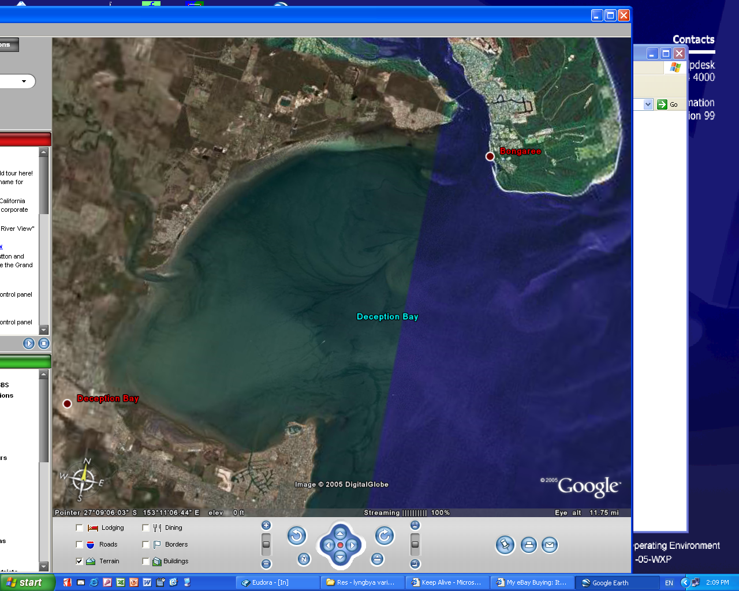
Translating science to management
Management Model
Science BN Model
P(Bloom Initiation)
Evaluation of factors, scenario assessment
Integration of information, adaptive updates

Slide 25
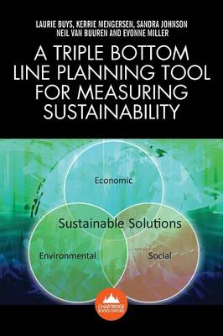
Case study: Sustainability of the Dairy Industry

Slide 26
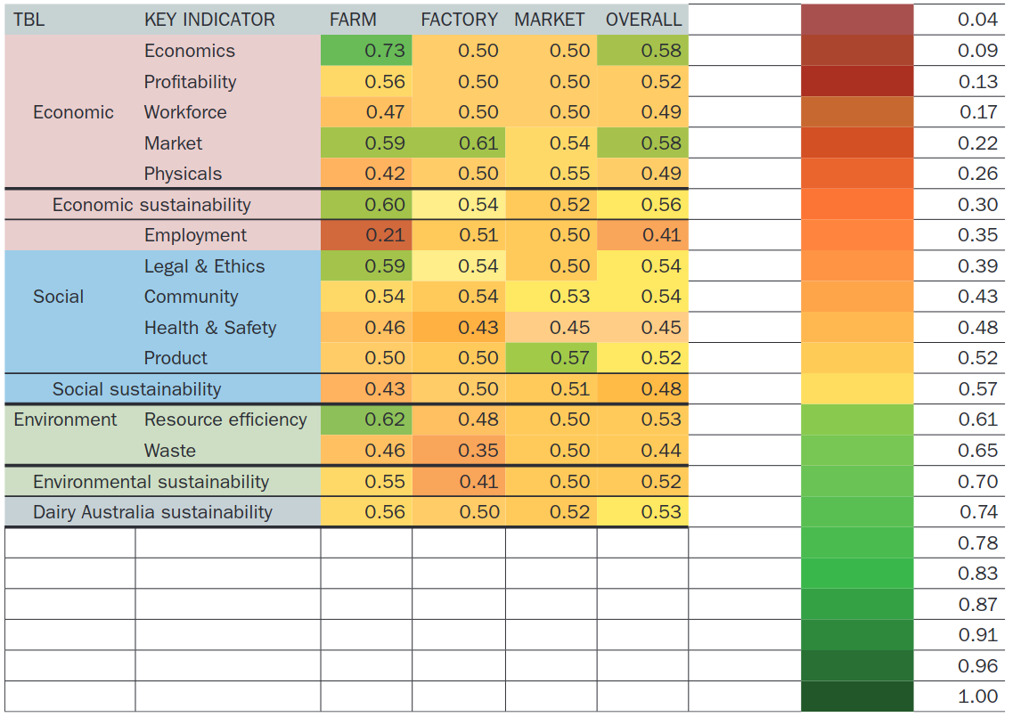
Where are we going with this?
The Strawman model
A strawman model is an initial example that can be used to demonstrate what we want to achieve and can be refined in the workshop by experts.
Why Expert Knowledge?
It helps to link and properly estimate the significance of vineyard factors. It overcomes the limitations of pure data structures, adding a greater level of reality to our findings.
Scenario Assessment
We can use the knowledge we have gained to review a scenario and how its outcomes will potentially change given different circumstances and approaches.
Notes:
The score cards can help to focus efforts appropriately.
Currently we can show where a vineyard sits relative to others but what can they do to effectively increase their sustainability? It is not always as simple as using less fuel, we want to understand what the driving factors behind why any given vineyard performs worse or better in terms of sustainability.

